Slide 1

Project Progress
Anastasia Kravale

Slide 2
About
Pitch an idea of an animated tv series, a pilot episode or short film, for The Big Pitcher.
Submitting an idea by Friday, 9th February, through the website.
Notifications announced Friday, 16th February.
Selected students will pitch at Animation Dingle Conference on 22nd March 2024.
Animate my idea.
Portfolio.

Slide 3
Been done
Three unsuccessful ideas.
Set on finale idea.

Slide 4
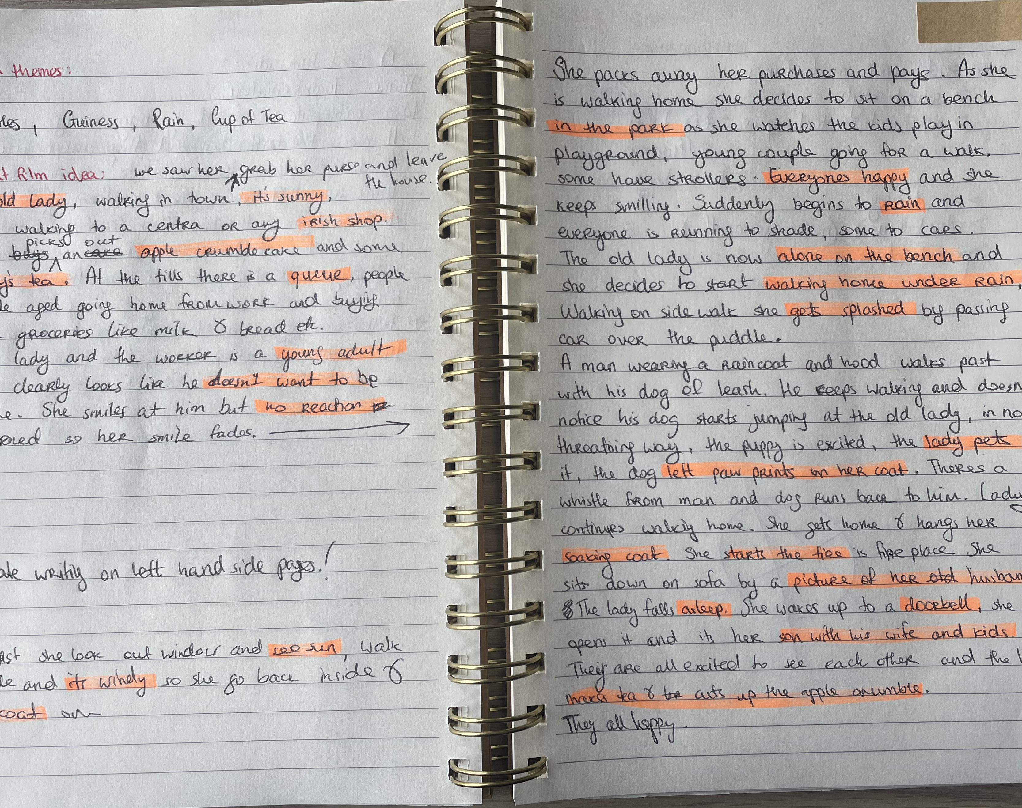
Successful idea

Slide 5
Left to do
Submit to The Big Pitcher.
Animate the idea.
Portfolio.

Slide 6
